Slide 1


Graphics Design I
Class 7
Lab 20

Slide 2


Way of Graphics Design
Online Tools
Offline Tools
Notes:
Notes to presenter:
Description of what you learned in your own words on one side.
Include information about the topic
Details about the topic will also be helpful here.
Tell the story of your learning experience. Just like a story there should always be a beginning, middle and an end.
On the other side, you can add a graphic that provides evidence of what you learned.
Feel free to use more than one slide to reflect upon your process. It also helps to add some video of your process.

Slide 3
Popular Online Tools
Canva
Inkscape
Krita
Pixlr
Gravit
Notes:
Notes to presenter:
Description of what you learned in your own words on one side.
Include information about the topic
Details about the topic will also be helpful here.
Tell the story of your learning experience. Just like a story there should always be a beginning, middle and an end.
On the other side, you can add a graphic that provides evidence of what you learned.
Feel free to use more than one slide to reflect upon your process. It also helps to add some video of your process.

Slide 4
Popular Offline Tools
Adobe Photoshop
Adobe Illustrator
Wacom Bamboo
PicMarkr
Pixlr
Notes:
Notes to presenter:
Description of what you learned in your own words on one side.
Include information about the topic
Details about the topic will also be helpful here.
Tell the story of your learning experience. Just like a story there should always be a beginning, middle and an end.
On the other side, you can add a graphic that provides evidence of what you learned.
Feel free to use more than one slide to reflect upon your process. It also helps to add some video of your process.

Slide 5

Graphics Design in Online Using Canva

Slide 6
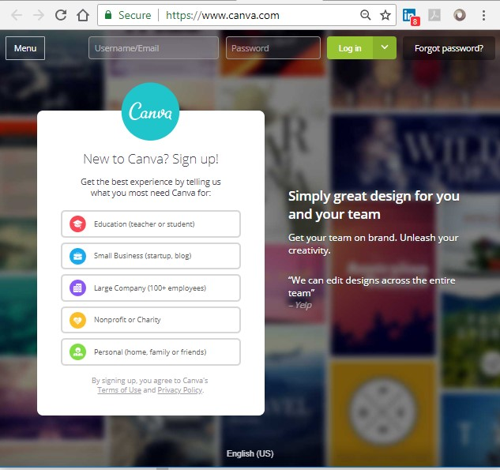
Log in to www.canva.com

Slide 7
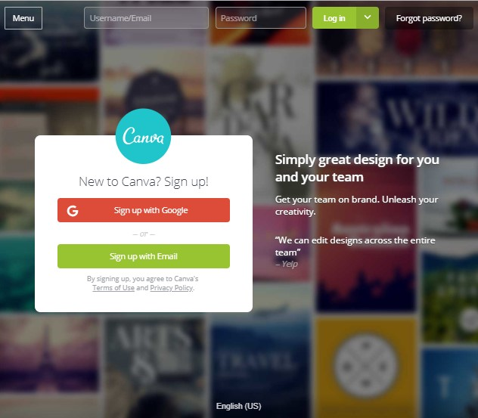
Sign up In Canva

Slide 8
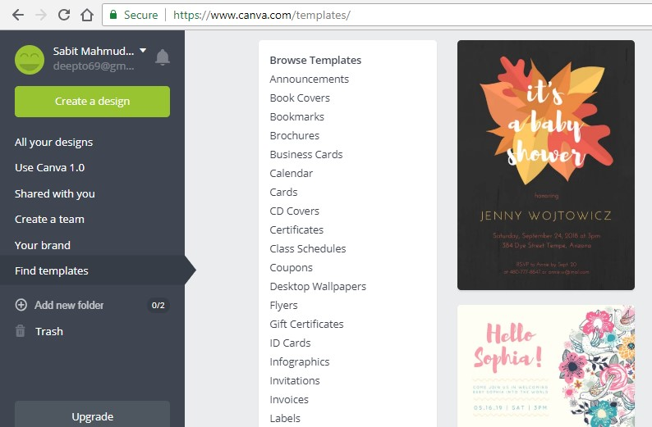
Choose any template

Slide 9
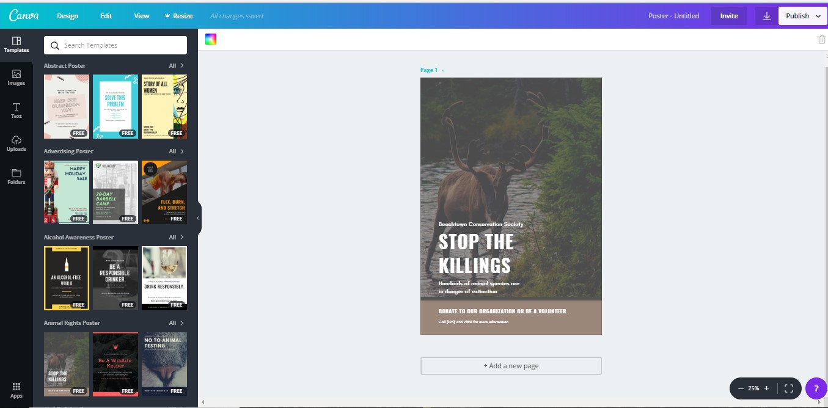
Change Text or Image

Slide 10
Change Text or Image

Slide 11

Save Your Design

Slide 12


